Slide 1
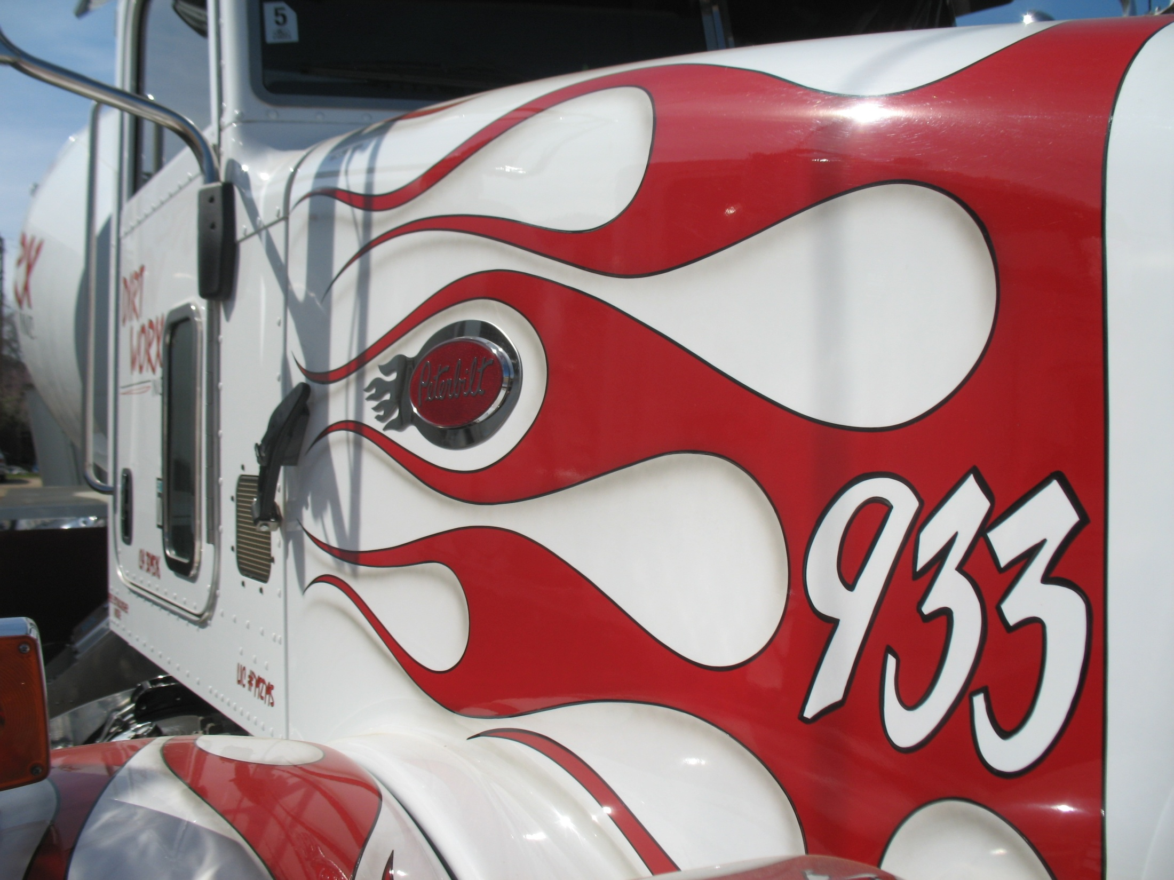
DIRT
WORX
INC.
2730 Unicorn Avenue
Bakersfield, CA 93308
661-393-5526
License #792795

Slide 2
Ownership
Jerry Frith, President
30 Years Concrete Experience
Brett Frith, Vice President
20 Years Concrete Experience

Slide 3
History
Established in 2001
Started out in R&R
Expanded into New Construction
2007 Diversification Plan

Slide 4
Safety First
All Employees are Passport Trained
MSHA Training
Certified Operators
JSPs, JSAs
Weekly Training
Employee Handbook/Safety Manual
Work Comp. Ex. Mod. = .94

Slide 5
Products/Services
Concrete Construction
Demolition
Saw Cutting and Core Drilling
Trucking
Crushing
Ag. Base Sales
Excavation
Steel Buildings Sales and Construction

Slide 6
Concrete Construction
Residential
Decorative Concrete
Foundations
Flat Work
Commercial
Foundations
Site Concrete
Industrial
Structural Concrete
Site Concrete

Slide 7
Residential
Residential

Slide 8
Commercial
Commercial

Slide 9
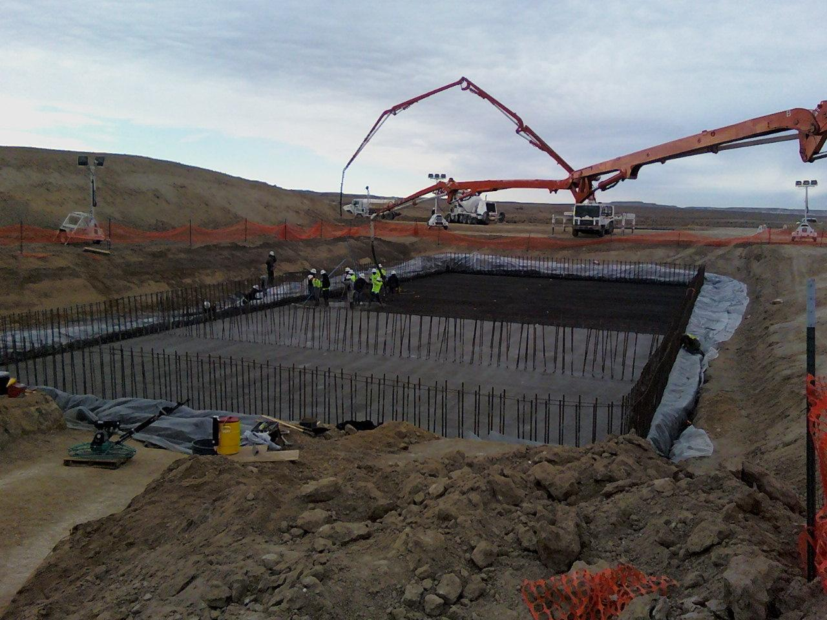
Industrial

Slide 10
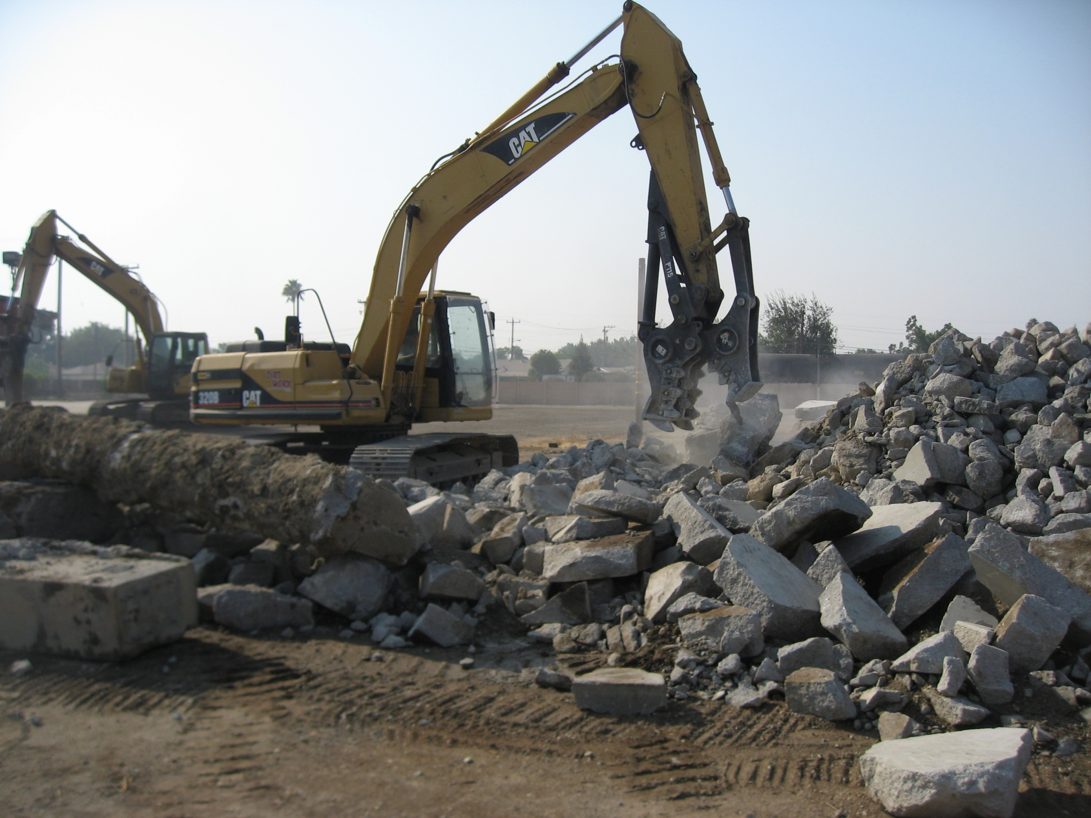
Demolition
Concrete/Asphalt
Breakers
Pulverizers
Soft Demo
Grapplers
Shears

Slide 11
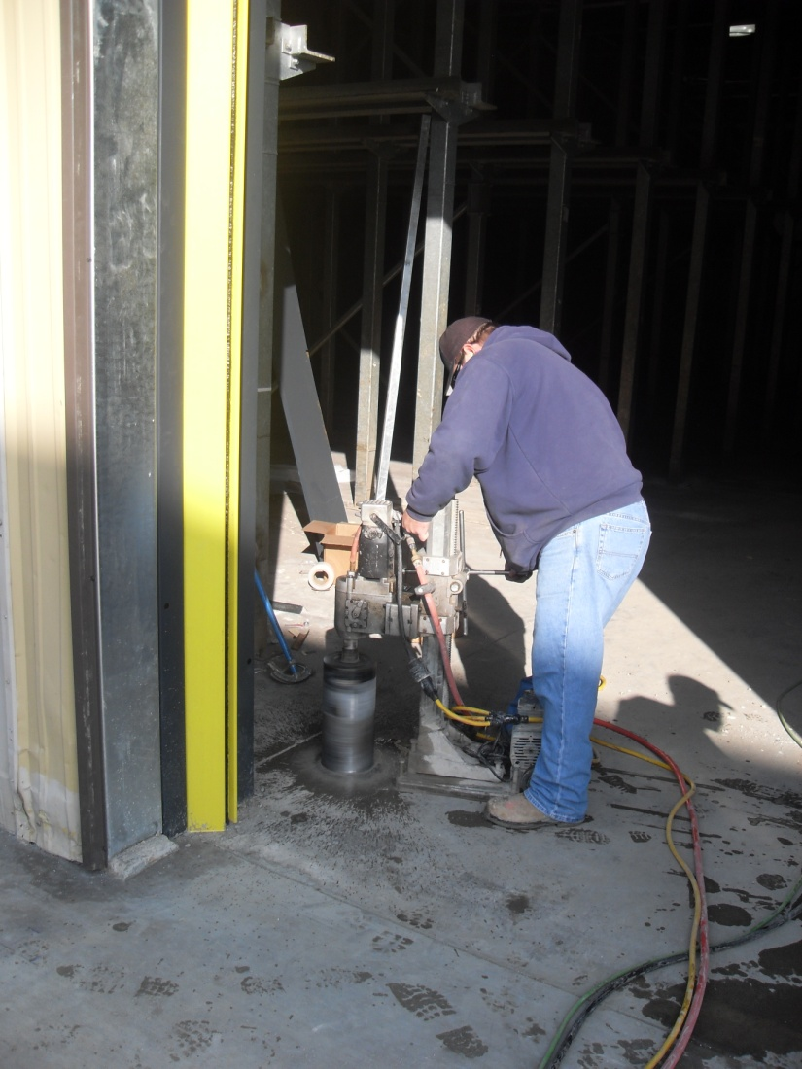
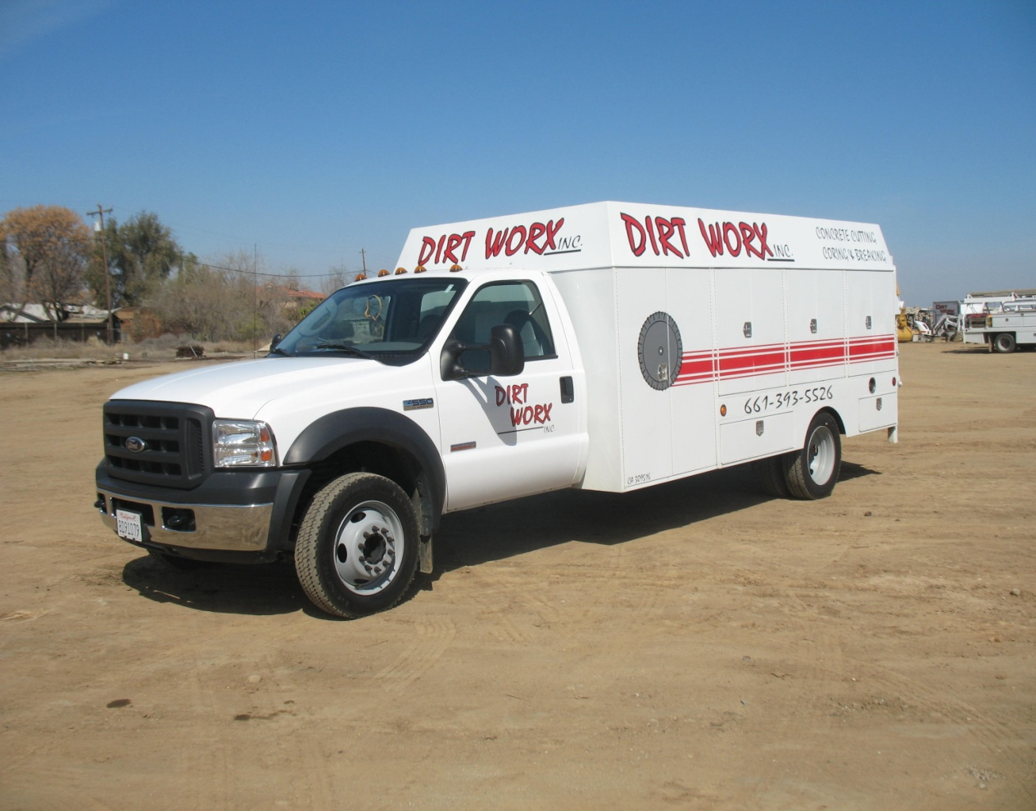
Saw Cutting/Core Drilling

Slide 12
Trucking
Transfer Trucks
Super 10 Wheelers
End Dumps
Ten Wheelers
Mixers

Slide 13
Transfer Truck

Slide 14
Super 10 Wheelers

Slide 15
Ten Wheelers

Slide 16
Mixers

Slide 17
Concrete/Asphalt Crushing
Fully Portable
CARB Permitted
Up to 250 Tons/Hour
Class II, Track Out Rock, etc.
Screening

Slide 18
Crusher

Slide 19
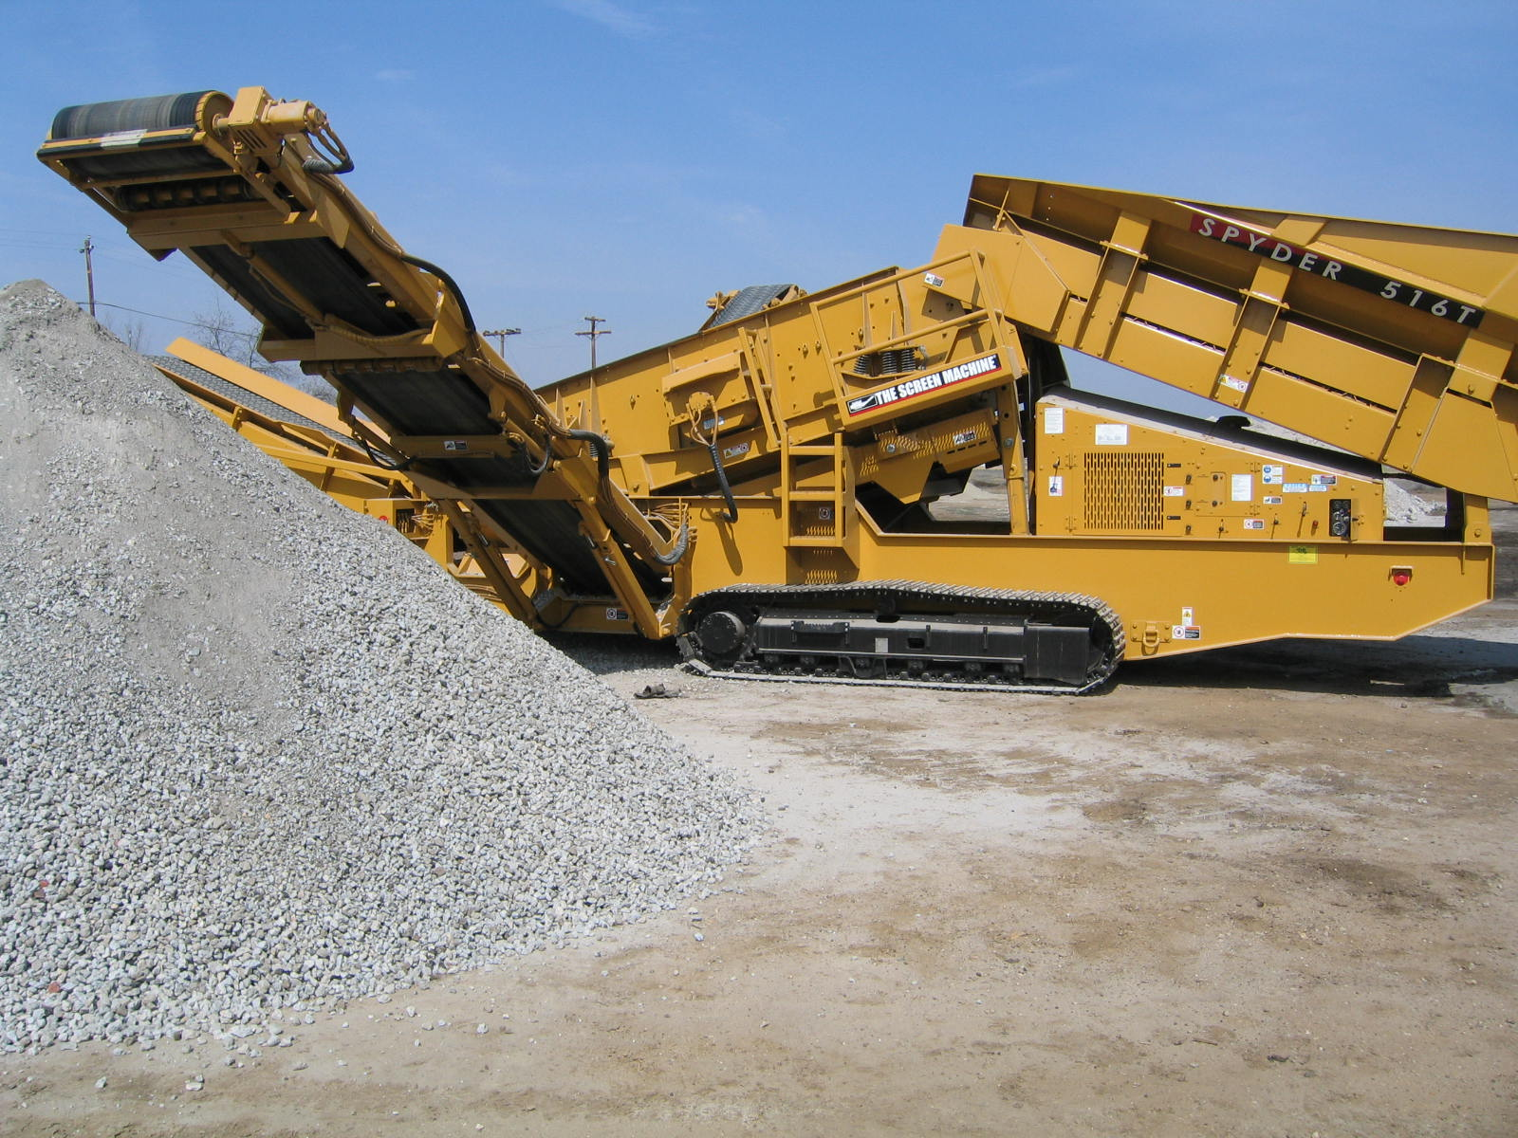
Ag. Base
Ag. Base

Slide 20
Excavation
Trenching
Well Locations
Rough Grading
Augering

Slide 21
Excavation Equipment
Excavators
Dozers
Loaders
Backhoes
Skid Steers
Mini Excavators

Slide 22
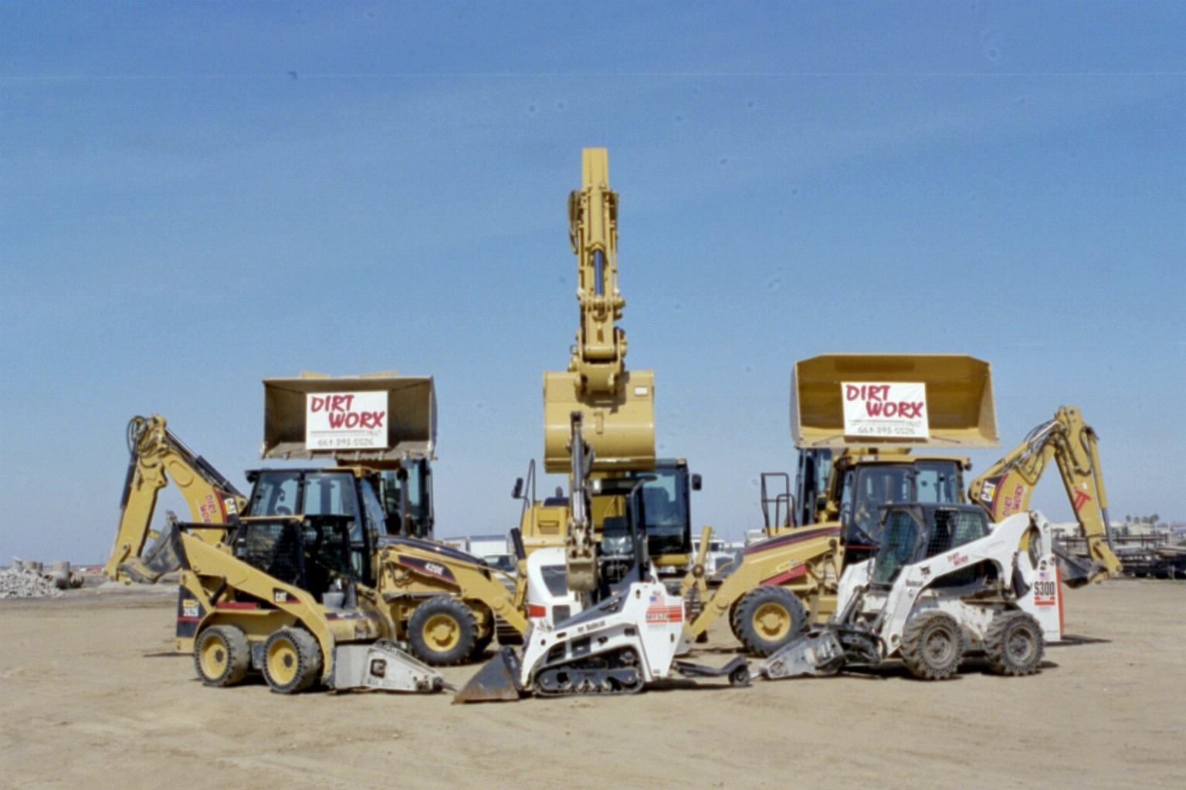
Excavation Equipment

Slide 23
Steel Buildings
Package Deals
Foundation, Building, TI’s, Permits
Multiple Dealers
Star
Borga
Metallic
Rockford

Slide 24
Summary
Full Service Concrete Company
Experienced Management Team
Business Philosophy
Safety
Quality
Productivity
Depth of Resources

Slide 25
DIRT
WORX
INC.
Questions?
(661) 393-5526

